Slide 1
Fine-Tuning BERT
Team 9: Cameron Rader, Sujit Tripathy, Befikir Bogale, William Parham

Slide 2

Introduction (Team 9)
Description: Use BERT out-of-the-box and fine-tune it to answer questions about the author's novels, evaluating how fine-tuning improves performance.
A Study in Scarlet by Sir Arthur Conan Doyle
Project 1: Plot Analysis
Project 2: General Question and Answer
2 approaches:
Enhanced context generation using RAG
Fine-Tuned BERT
Notes:
Project 1 aimed to answer plot analysis questions such as when a murder happens.
Project 2 aims to answer general questions about the text such as “Who introduced Sherlock to Watson”.

Slide 3
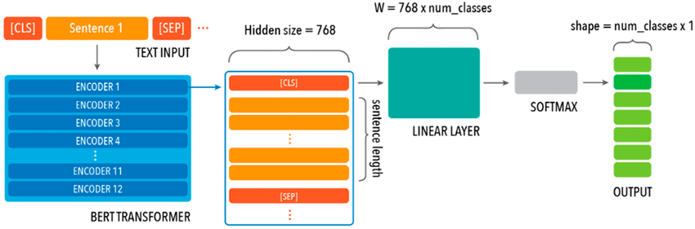
Out of the Box Model
The model:
BERT Architecture
bert-base-uncased
Casing makes no difference
110 million parameters
Trained with English
512 token context window
Pretrained with:
'BookCorpus' dataset
English Wikipedia
Introduced in:
BERT: Pre-training of Deep Bidirectional Transformers for Language Understanding¹
Notes:
We will probably want to be able to explain this architecture.
What is the CLS and sep token?
What is a BERT transformer?
What does hidden size mean?
What is a linear layer?
Why softmax?
Figure came from here:
https://www.researchgate.net/figure/BERT-base-uncased-model-architecture-which-comprises-12-transformer-block-layers-each_fig2_374608193

Slide 4
RAG
Query
Retrieval Augmented Generation
RAG
Why?
We cannot fit the entire novel into the BERT context window.
Window is only 512 tokens.
Idea:
Can enhanced query alone support BERT without fine-tuning?
Parts:
Chunking method
Embedding method
SBERT
Context
Model
Answer
Notes:
We pass our query into RAG to generate an enhanced context.
This allows our model to give a more accurate answer.
We find the top ‘k’ most relevant embeddings and pass in their corresponding chunks / sentences / paragraphs.
To find k we compute a cosine similarity between our embedded query and our embedded chunks / sentences / paragraphs.

Slide 5
RAG³
RAG Pipeline
Retrieval Augmented Generation
query
Input = Instruction + search results + question
Why?
We cannot fit the entire novel into the BERT context window.
Window is only 512 tokens.
Idea:
Can enhanced query alone support BERT without fine-tuning?
Parts:
Chunking method
Embedding method
SBERT
Search
Document
(A Study in Scarlet)
Bert Model
Top Search Results
Answer
Notes:
We pass our query into RAG to generate an enhanced context.
This allows our model to give a more accurate answer.
We find the top ‘k’ most relevant embeddings and pass in their corresponding chunks / sentences / paragraphs.
To find k we compute a cosine similarity between our embedded query and our embedded chunks / sentences / paragraphs.

Slide 6
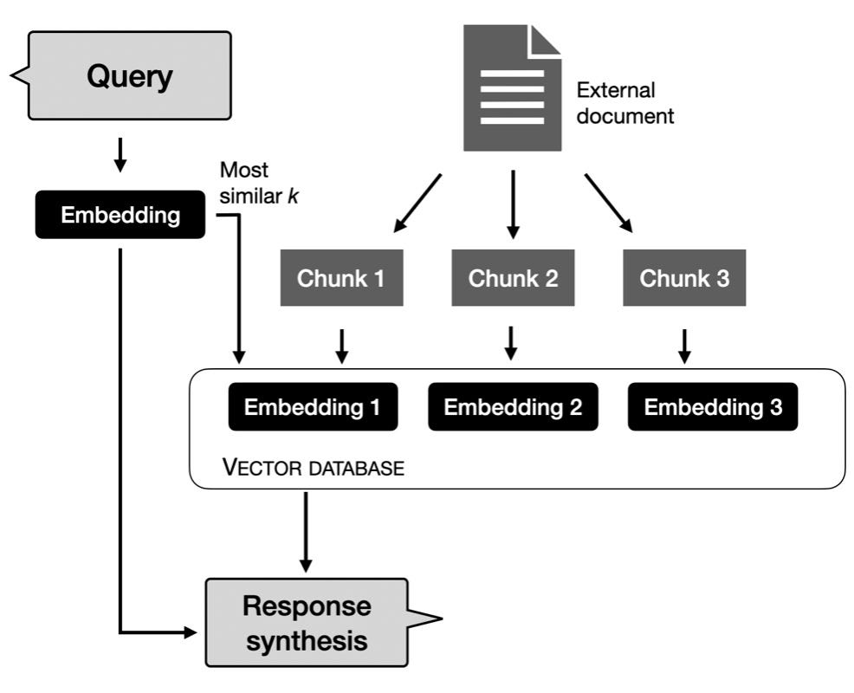
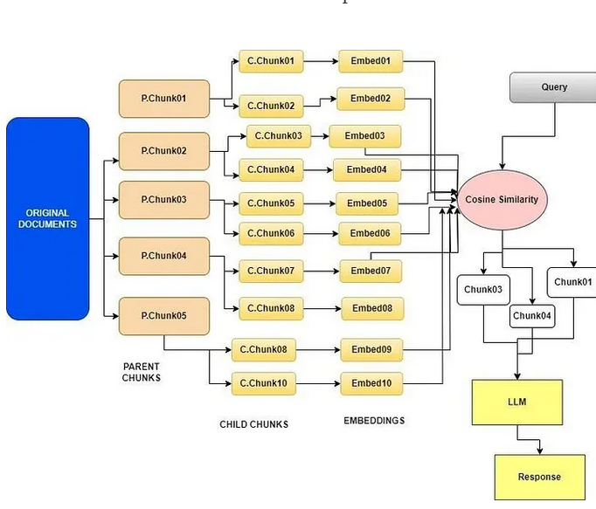
RAG Methods
A Few Approaches:
Sentence Chunking
Paragraph Chunking
Quickly overcomes context window
Scene Chunking
Phrase Chunking
Good at finding specific passages of text.
Semantic Chunking
Good at dealing with more complex questions
Notes:
We tried many methodologies getting more complex as we tried new ones.
We wanted a few easy methodologies to act as a baseline for comparison.
Some methodologies are better at certain things than others.
Phrase chunking is great when finding small factual answers.
Semantic chunking is good for more complex long answers.

Slide 7
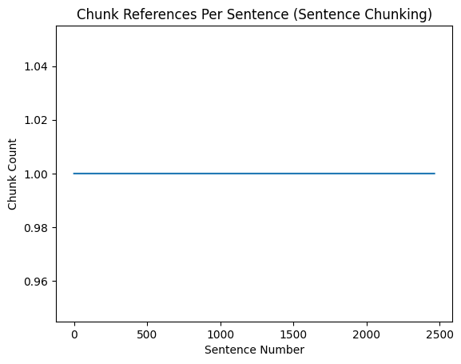
RAG – Sentence Chunking
Idea:
Tokenize the novel at the sentence level.
Create chunks of sentences less than or equal to 256 tokens.
Preserve breaks in sentences.
Basic and fast implementation.
Provides a baseline.
Notes:
Fast and easy baseline.
This is what we can compare to.
Even this gave us a context with an answer, however, it may not always be in the context window.
To combat with falling out of the context window we create chunk sizes of 256 tokens.
Guarantee we get 2 chunks of context.
This graph looks terrible but it makes sense.
Each chunk only references a sentence once.
If a sentence would go over the chunk size limit we create a new chunk.

Slide 8
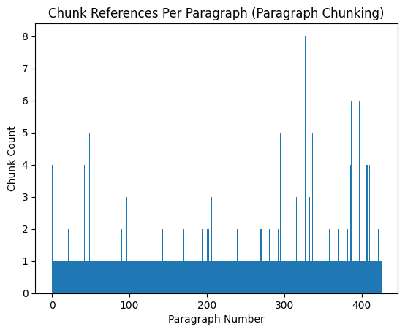
RAG – Paragraph Chunking
Idea:
Tokenize the novel at the paragraph level.
Create chunks of paragraphs less than or equal to 256 tokens.
Preserve breaks in paragraphs.
This will result in a larger similar context.
Falls out of the context window extremely fast.
Notes:
Creates chunks that quickly fall out of the context window.
To combat this, we create a new chunk once we reach 256 tokens or a break in a paragraph.
This graph shows that each chunk generally corresponds to one paragraph, however, there are outlier paragraphs with many chunks.
This indicates a very long paragraph.

Slide 9
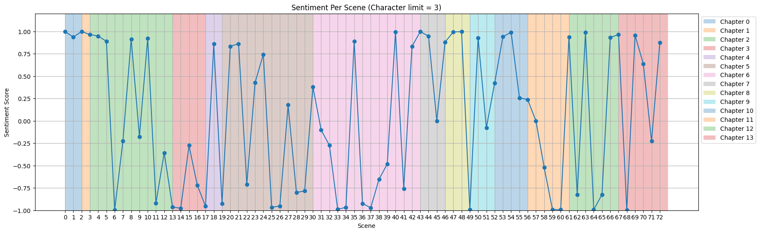
RAG – Scene Chunking
Idea:
Chunking based on scenes is an attempt at capturing shifts within the novel.
Allows us to group based on plot changes.
Chunk sizes varied greatly across scenes.
Resulted in the model giving incoherent responses.
We explored a chunking strategy based on scenes, treating each scene as an individual chunk for processing. However, this approach did not yield the desired results.
Notes:
Befikir, I will leave this to you! Please change the slide and these notes as you see fit.

Slide 10
RAG – Scene Chunking
Chunk = [Characters Present][Sentences]
Idea:
Chunking based on scenes is an attempt at capturing shifts within the novel.
Allows us to group based on plot changes.
Chunk sizes varied greatly across scenes.
Resulted in the model giving incoherent responses.
We experimented with modifying the scene chunking by associating each chunk with a list of characters present, but this did not improve the results.
Notes:
Befikir, I will leave this to you! Please change the slide and these notes as you see fit.

Slide 11
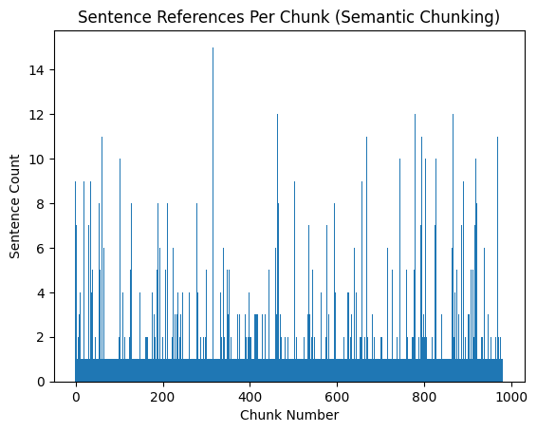
RAG – Semantic Chunking
Idea:
Tokenize at the sentence level and calculate embeddings for the sentences.
Use cosine similarity to group them into semantically similar chunks of size 256.
This will preserve semantic similarity between passages and provide context only with very similar semantic meaning.
Notes:
Continuous and non-continuous semantic chunking.
Need to limit chunk sizes to 256 tokens, but the chunks don’t generally get that large.
Chunks tended to be smaller in nature.
Larger than sentences, smaller than paragraphs.

Slide 12
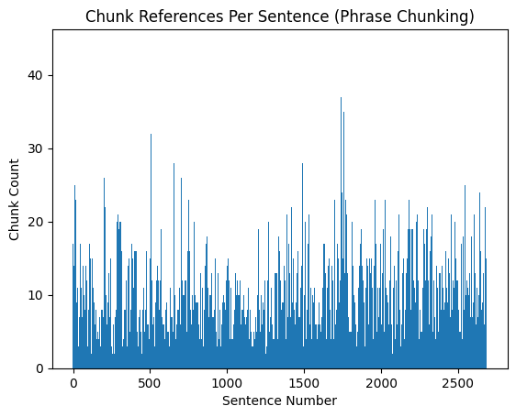
RAG – Phrase Chunking
Idea:
Create small chunks of “phrases”.
4 tokens
2 token overlap window
Almost always found correct answers eventually.
Context created by extracting sentences that include chunk.
Can fall out of context window if not careful.
Good at finding small factual answers.
Notes:
Phrase chunking performed well on tasks like: “what was written on the wall in blood”.
A typical answer is “the inscription” with the context being “RACHE was the inscription on the wall”.

Slide 13
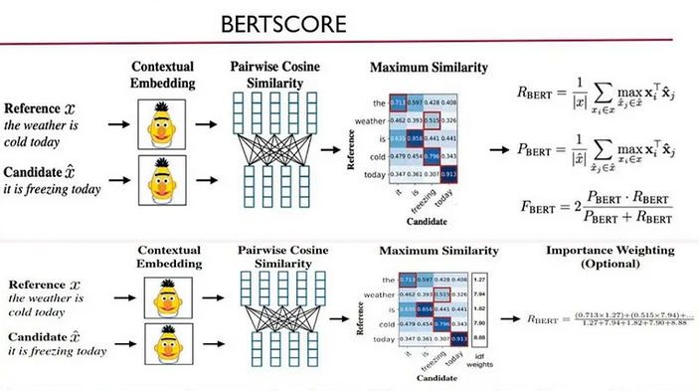
Bert Score²
Reason:
Used to evaluate semantic similarity.
Model may give different answers
Same semantic meaning
Notes:
Phrase chunking performed well on tasks like: “what was written on the wall in blood”.
A typical answer is “the inscription” with the context being “RACHE was the inscription on the wall”.
Image comes from here: https://medium.com/@abonia/bertscore-explained-in-5-minutes-0b98553bfb71

Slide 14
RAG – Observations and Results
Observation:
Results:
Evaluated using 70 Question – Answer – Context (QAC) set.
Comparing generated context & answer from RAG pipeline with reference answer & context from QAC set.
Semantic similarity calculated using BERTscore
We believe the issue is a lack of a larger context window.
RAG was able to generate a context that contained the answer; however, the answer was not always within the context window.
BERT Score Evaluation Metrics
 | Recursive Chunking |  | Paragraph Chunking |  | Sentence Chunking
 | Context | Answer | Context | Answer | Context | Answer
Precision | 0.3526 | 0.3051 | 0.3543 | 0.3166 | 0.3521 | 0.3109
Recall | 0.5189 | 0.3537 | 0.5197 | 0.3541 | 0.5146 | 0.3276
F1 | 0.4193 | 0.3241 | 0.4207 | 0.3299 | 0.4175 | 0.3146
 | Semantic Chunking |  | Phrase Chunking |  | Non-Continuous Semantic Chunking
 | Context | Answer | Context | Answer | Context | Answer
Precision | 0.3882 | 0.3075 | 0.398 | 0.3719 | 0.3536 | 0.323
Recall | 0.5012 | 0.3429 | 0.4749 | 0.3749 | 0.5038 | 0.3661
F1 | 0.437 | 0.3217 | 0.4325 | 0.3688 | 0.4149 | 0.3406
Notes:
RAG alone was not enough to solve a lack of fine-tuning and training with the BERT model.
When testing our approaches with a fine-tuned model we saw significant improvement and answers that made sense.
This makes sense as a stronger model and larger context window generally make a better QA model.
Phrase chunking seems to generally perform the best.

Slide 15
RAG – Observations and Results
 |  | Recursive Chunking | Paragraph Chunking | Sentence Chunking
Ground Truth | Context | ...is introduced to Sherlock Holmes by Stamford | Holmes believed that knowledge not directly relevant to his work should be discarded, arguing… | Holmes believed that knowledge not directly relevant to his work should be discarded, arguing that the brain has limited capacity
 | Question | Who introduced Watson to Holmes? | What was Holmes' argument against cluttering the brain? | Why did Holmes believe irrelevant knowledge should be discarded?
 | Answer | Stamford | which should not be cluttered with irrelevant facts. | the brain has limited capacity
Generated | Context | lawyer i suppose. his writing has a legal twist about it... | reason to remember that i rose somewhat earlier than usual… | Theres more work to be got out of one of those little beggars than
 | Question | Who introduced Watson to Holmes? | What was Holmes' argument against cluttering the brain? | Why did Holmes believe irrelevant knowledge should be discarded?
 | Answer | exuberance of my joy i asked him to lunch with me at the holborn | gregson of scotland yard. sherlock holmes | Theres more work to be got out
 |  | Semantic Chunking | Non-Continuous Semantic Chunking | Phrase Chunking
Ground Truth | Context | deducing exactly where he had been walking in London. | Holmes deduced that the murderer had arrived in a cab with his victim | They decide to share an apartment at 221B Baker Street.
 | Question | What could Holmes deduce from splashes on his trousers? | Who did Holmes believe arrived in the cab? | Where did Watson and Holmes live?
 | Answer | exactly where he had been walking in London | the murderer had arrived in a cab with his victim | 221B Baker Street
Generated | Context | Holmes took a halfsovereign from his pocket and played with it pensively… | You did not come here in a cab? asked Sherlock Holmes… | We have been hearing Gregsons view of the matter Holmes observed…
 | Question | What could Holmes deduce from splashes on his trousers? | Who did Holmes believe arrived in the cab? | Where did Watson and Holmes live?
 | Answer | . | Holmes was engaged in his favourite occupation of scraping upon his violin. | does not simplify them? observed Holmes
Notes:
RAG alone was not enough to solve a lack of fine-tuning and training with the BERT model.
When testing our approaches with a fine-tuned model we saw significant improvement and answers that made sense.
This makes sense as a stronger model and larger context window generally make a better QA model.
Phrase chunking seems to generally perform the best.

Slide 16
RAG – Observations and Results
 |  | Recursive Chunking
Ground Truth | Context | ...is introduced to Sherlock Holmes by Stamford
 | Question | Who introduced Watson to Holmes?
 | Answer | Stamford
Generated | Context | lawyer i suppose. his writing has a legal twist about it...
 | Question | Who introduced Watson to Holmes?
 | Answer | exuberance of my joy i asked him to lunch with me at the holborn
Notes:
RAG alone was not enough to solve a lack of fine-tuning and training with the BERT model.
When testing our approaches with a fine-tuned model we saw significant improvement and answers that made sense.
This makes sense as a stronger model and larger context window generally make a better QA model.
Phrase chunking seems to generally perform the best.

Slide 17
QA Pipeline
Manual QA Dataset
Tokenize QA Dataset
Fine-Tune BERT with QA's
Calculate BERTScore
Compare Inference Results
Automatic QA Dataset
Create QA Dataset
Manual setup
Automated creation
Tokenize QA Dataset
Tokenize the dataset
Ensure proper character level to token level mapping of answer in context
Fine-Tune BERT w/Dataset
Use tokenized input to provide better output
Calculate evaluation metrics and assess inference results
BERTScore provides model evaluation metrics
Inference results display model responses to questions after fine tuning

Slide 18
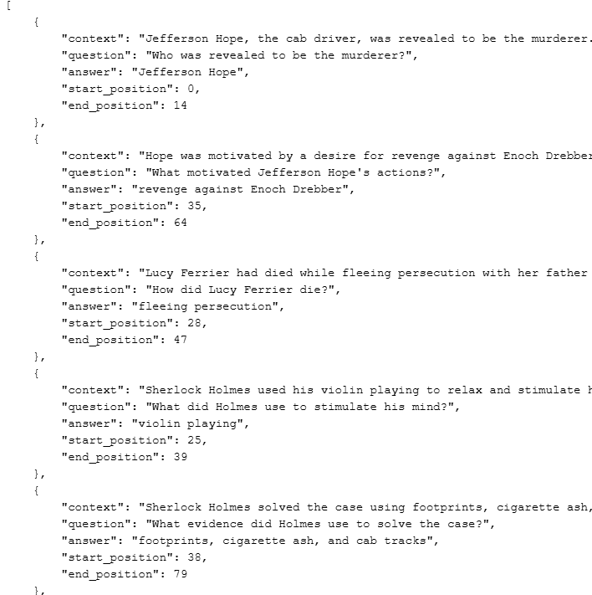
QA Dataset
Context/Question/Answer Dataset used as the input for the Out-of-Box BERT model (Bert-Based-Uncased).
4 Key Components:
Context
Question
Answer
Start/End position of Answer in Context
Dual dataset creation approach
Manual
Automated

Slide 19
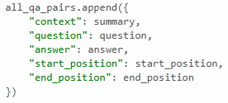
Dual Approach
Automated (700 Samples)
Manual (250 Samples)
Context Creation:
model="google/pegasus-large"
Chunk the text and generate summaries of those chunks (max token 1024)
Question Creation:
model="mrm8488/t5-base-finetuned-question-generation-ap"
Generate the questions based on that summary (max token 512)
Answer Creation:
model="deepset/roberta-large-squad2"
Retrieve an answer for said question (max token 384)
Manual Creation:
Summarize passage of text
Generate insightful question(s) about the summary
Pair the answer to those question(s)

Slide 20
Tokenizing the QA Dataset
Utilizes "BertTokenizerFast" to tokenize both the manual and automated QA datasets
Challenge
Maintaining the start and end position of answers in context during tokenization
Solution
A transition function to map character level indices to token level indices
Maintains the model's ability to map Context -> Question -> Answer while tokenized

Slide 21
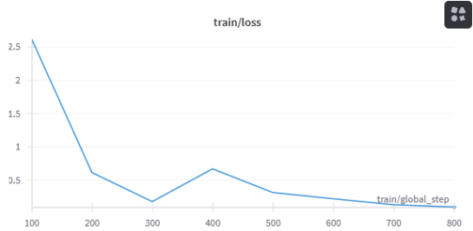
Model Training
After tokenizing both the manual and automated QA datasets, we take the 2 tokenized datasets and use them as inputs to our model independently
Bert-Based-Uncased
Step based evaluation system with 3-10 epochs to avoid overfitting

Slide 22
Inference Evaluation
Inference Dataset
Created to test and compare the performance between:
Out-of-Box BERT
Manually fine-tuned model
Automated QA fine-tuned model
Manually created with 70 Context/Question/Answer samples
Inference dataset comprised of samples separate from the training process to provide un-biased evaluation

Slide 23
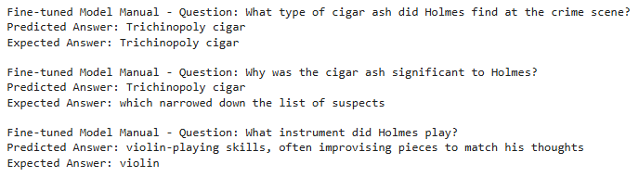
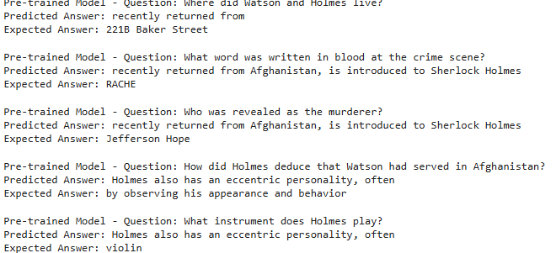
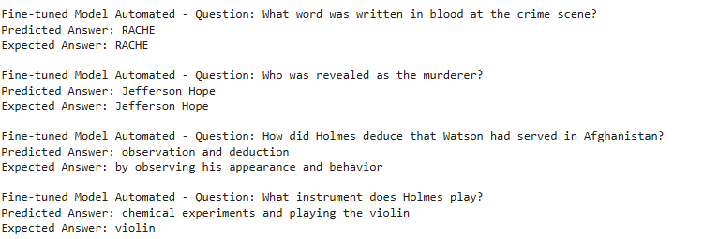
Manual-QA Fine-Tuned Model
Inference Comparison
Out-of-Box Model
Automated-QA Fine-Tuned Model

Slide 24
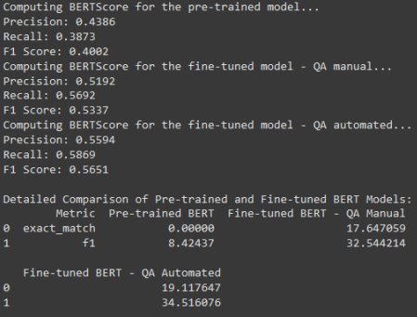
BERTScore Evalution²
Model Predictions (Answers) vs References (Ground Truth)
Unlike traditional metrics (e.g., exact match or F1), BERTScore evaluates the semantic similarity between predicted and reference answers, capturing meaning even if wording differs.
Helps identify subtle improvements or degradations in answer quality when fine-tuning models or generating questions automatically.
Bottom Metrics depict Traditional EM/F1 scores where the top displays the BERTScore evaluation
Notes:
Bert score helps to account for semantic similarity.
Sometimes our model may give different responses that mean the same thing!
This is why we are using BERT score.
Bert score is being used to evaluate semantic similarity between context and answer.

Slide 25
QA Creation Conclusion
Proper Fine-Tuning requires a vast amount of data samples to provide a base model like BERT
As we increased the QA sample size the model improved
Quality of the input data mattered just as much as the quantity of samples
Ensuring proper tokenization of natural language datasets proved challenging
Why? Mapping Start/end positions of answer in context (tough to verify)
Implications? Garbage in – Garbage out

Slide 26
References
1. BERT: Pre-training of Deep Bidirectional Transformers for Language Understanding (Jacob Devlin, Ming-Wei Chang, Kenton Lee, Kristina Toutanova) Google Ai Language
2. BERT Score evaluation metrics: https://huggingface.co/spaces/evaluate-metric/bertscore
3. Retrieval-Augmented Generation for Knowledge-Intensive NLP Tasks (Patrick Lewis, Ethan Perez, Aleksandra Piktus, Fabio Petroni….)
https://medium.com/@thallyscostalat/chunking-strategies-optimization-for-retrieval-augmented-generation-rag-in-the-context-of-e47cc949931d

Slide 27
References
[1] Devlin, J., Chang, M.-W., Lee, K., & Toutanova, K. (2019). BERT: Pre-training of Deep Bidirectional Transformers for Language Understanding. Google AI Language. Available at arXiv:1810.04805.
[2] Hugging Face. (n.d.). BERTScore Evaluation Metrics. Available at https://huggingface.co/spaces/evaluate-metric/bertscore.
[3] Lewis, P., Perez, E., Piktus, A., Petroni, F., et al. (2020). Retrieval-Augmented Generation for Knowledge-Intensive NLP Tasks. Available at arXiv:2005.11401.
[4] Costa, T. (2023). Chunking Strategies Optimization for Retrieval-Augmented Generation (RAG) in the Context of Knowledge-Intensive NLP. Available at https://medium.com/@thallyscostalat/chunking-strategies-optimization-for-retrieval-augmented-generation-rag-in-the-context-of-e47cc949931d.
[5] Sojasingarayar A. (2019). BERTScore Explained in 5 minutes. Medium. Available at https://medium.com/@abonia/bertscore-explained-in-5-minutes-0b98553bfb71 .

